Slide 1

Sequential Logic Circuits
By
Dr.Rohit Lorenzo
Assistant Professor Sr. Grade -1
School of Electronics Engineering (SENSE)

Slide 2
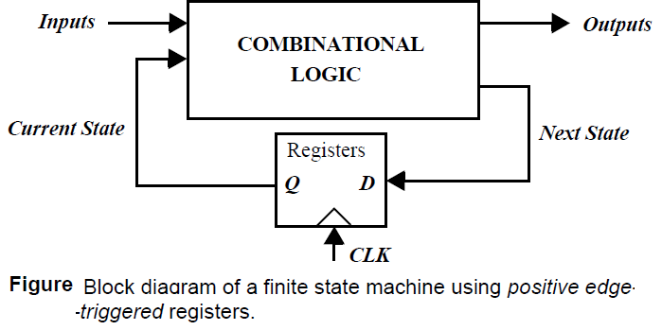
Introduction
All useful systems require storage of state information, leading to another class of circuits called sequential logic circuits.
In these circuits, the output not only depends upon the current values of the inputs, but also upon preceding input values. In other words, a sequential circuit remembers some of the history of the system—it has memory.
The system depicted here belongs to the class of synchronous sequential systems, in which all registers are under control of a single global clock.
The outputs of the FSM are a function of the current Inputs and the Current State. The Next State is determined based on the Current State and the current Inputs and is fed to the inputs of registers.
On the rising edge of the clock, the Next State bits are copied to the outputs of the registers (after some propagation delay), and a new cycle begins. The register then ignores changes in the input signals until the next rising edge. In general

Slide 3
Timing Metrics for Sequential Circuits
The set-up time (t_{su}) is the time that the data inputs (D input) must be valid before the clock transition
The hold time (t_{hold}) is the time the data input must remain valid after the clock edge.
Assuming that the set-up and hold-times are met, the data at the D input is copied to the Q output after a worst-case propagation delay (with reference to the clock edge) denoted by t_{c-q}.
Assume that the worst-case propagation delay of the logic equals t_{plogic}, while its minimum delay (also called the contamination delay) is t_{cd}. The minimum clock period T, required for proper operation of the sequential circuit is given by
……… (1)
The hold time of the register imposes an extra constraint for proper operation.
……….(2)
where t_{cd} register is the minimum propagation delay (or contamination delay) of the register.

Slide 4
Continuing……
As seen from Eq. (1), it is important to minimize the values of the timing parameters associated with the register, as these directly affect the rate at which a sequential circuit can be clocked.

Slide 5
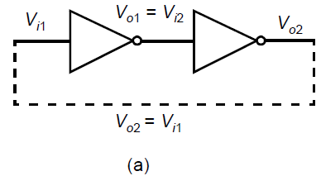
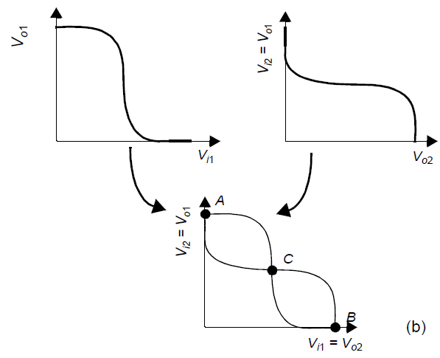
Static Latches and Registers
The Bistability Principle
Static memories use positive feedback to create a bistable circuit — a circuit having two stable states that represent 0 and 1.
The basic idea is two inverters connected in cascade along with a voltage-transfer characteristic typical of such a circuit. The resulting circuit has only three possible operation points (A, B, and C), as demonstrated on the combined VTC.

Slide 6
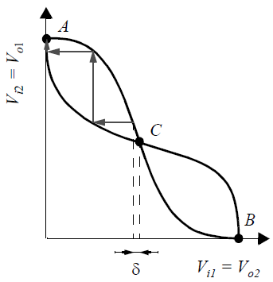
Static Properties of Complementary CMOS Gates
Under the condition that the gain of the inverter in the transient region is larger than 1, only A and B are stable operation points, and C is a metastable operation point.
Suppose that the cross-coupled inverter pair is biased at point C. A small deviation from this bias point, possibly caused by noise, is amplified and regenerated around the circuit loop.
A small deviation δ is applied to V_{i1} (biased in C). The bias point
moves away from C until one of the operation points A or B is
reached.
Every deviation (even the smallest one) causes the operation point
to run away from its original bias.Operation points with this property
are termed metastable.

Slide 7
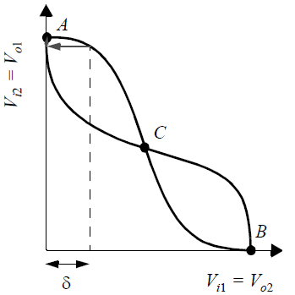
continue…..
On the other hand, A and B are stable operation points, as demonstrated in Figure. In these points, the loop
gain is much smaller than unity. Even a rather large deviation from the operation point is reduced in size and
disappears.
Hence the cross-coupling of two inverters results in a bistable circuit, that is, a circuit with two stable states, each corresponding to a logic state. The circuit serves as a memory, storing either a 1 or a 0 (corresponding to positions A and B).
In order to change the stored value, we must be able to bring the circuit
from state A to B and vice-versa.we can achieve this by making A (or B)
temporarily unstable by increasing G to a value larger than 1. This is
generally done by applying a trigger pulse at V_{i1} or V_{i2}.
In absence of any triggering, the circuit remains in a single state

Slide 8
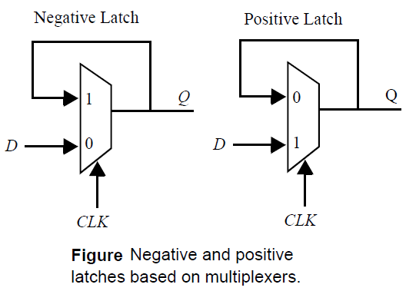
Multiplexer-based latches
The most robust and common technique to build a latch involves the use of transmission gate multiplexers.
Figure shows an implementation of static positive and negative latches based on multiplexers. For a negative latch, when the clock signal is low, the input 0 of the multiplexer is selected, and the D input is passed to the output.
When the clock signal is high, the input 1 of the multiplexer, which connects to the output of the latch, is selected. The feedback holds the output stable while the clock signal is high.
Similarly in the positive latch, the D input is selected.

Slide 9
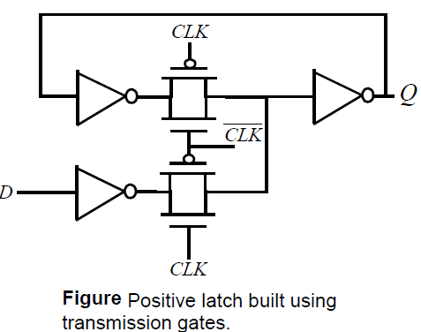
Transistor level implementation of latches
A transistor level implementation of a positive latch based on multiplexers is shown in figure. When CLK is high, the bottom transmission gate is on and the latch is transparent - that is, the D input is copied to the Q output.
During this phase, the feedback loop is open since the top transmission gate is off. This particular latch implementation is not particularly efficient from this metric as it presents a load of 4 transistors to the CLK signal.

Slide 10
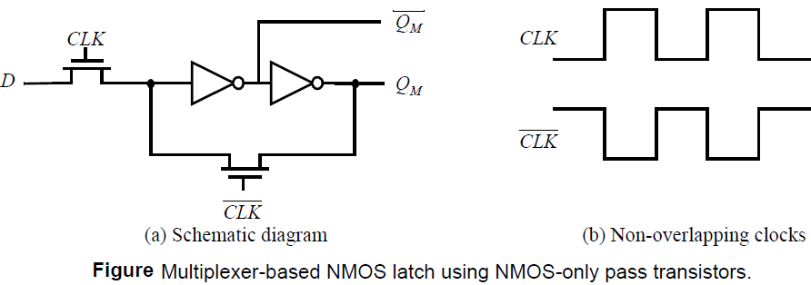
Continue….
It is possible to reduce the clock load to two transistors by using implement multiplexers using NMOS only pass transistor. The advantage of this approach is the reduced clock load of only two NMOS devices.
When CLK is high, the latch samples the D input, while a low clock-signal enables the feedback-loop and puts the latch in the hold mode.
the use of NMOS only passtransistors results in the passing of a degraded high voltage of V_{DD} - V_{Tn} to the input of the
first inverter. This impacts both noise margin and the switching performance, especially in
The case of low values of V_{DD} and high values of V_{Tn}. It also causes static power dissipationin first inverter

Slide 11
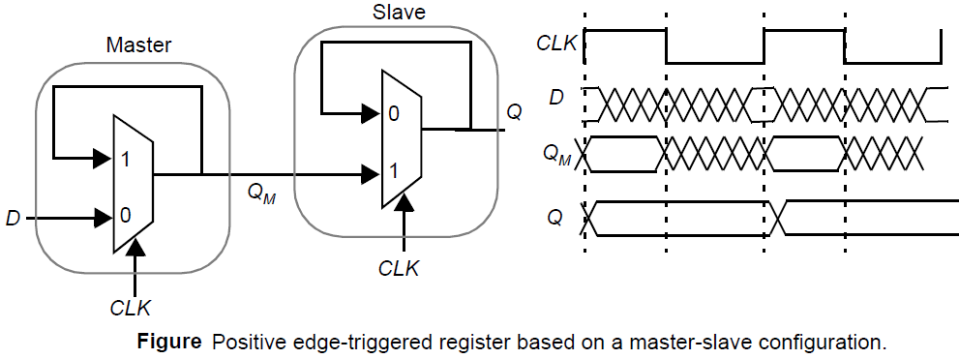
Master-Slave Edge-Triggered Register
The most common approach for constructing an edge-triggered register is to use a master slave configuration.
The register consists of cascading a negative latch (master stage) with a positive latch (slave stage).
On the low phase of the clock, the master stage is transparent, and the D input is passed to the master stage output Q_{M}. During this period, the slave stage is in the hold mode, keeping its previous valueusing feedback.
On the rising edge of the clock, the master slave stops sampling the input, and the slave stage starts sampling.
During the high phase of the clock, the slave stage
samples the output of the master stage (QM), while the master stage remains in a hold mode.

Slide 12
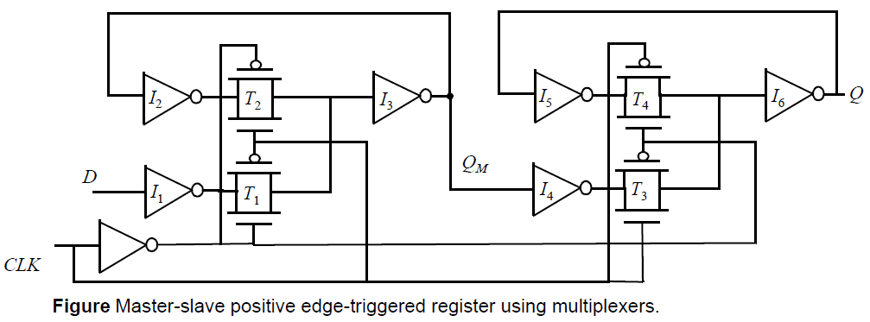
Transistor-level implementation of the master-slave positive edge-triggered register
A complete transistor-level implementation of the master-slave positive edge-triggered register. When the clock is low , T₁ is on and T₂ is off, and the D input is sampled onto node Q_{M}.
During this period, T₃ is off and T₄ is on and the cross-coupled inverters (I₅, I₆) holds the state of the slave latch. When the clock goes high, the master stage stops sampling the input and goes into a hold mode.
T₁ is off and T₂ is on, and the cross coupled inverters I3 and I4 holds the state of Q_{M}. Also, T₃ is on and T₄ is off, and Q_{M} is copied to the output Q.

Slide 13
Timing Properties of Multiplexer-based Master-Slave Registers
Registers are characterized by three important timing parameters: the set-up time, the hold time and the propagation delay.
Assume that the propagation delay of each inverter is tpd_inv, and the propagation delay of the transmission gate is tpd_tx.
The transmission gate multiplexer-based register, the input D has to propagate through I₁, T₁, I₃ and I₂ before the rising edge of the clock . The set-up time is therefore equal to 3 *t_{pd_inv} + t_{pd_tx}.
The propagation delay is the time for the value of QM to propagate to the output Q. Therefore the delay tc-q is simply the delay through T₃ and I₆ (t_{c-q} = t_{pd_tx} + t_{pd_inv}).
The transmission gate T1 turns off when clock goes high and therefore any changes in the D-input after clock going high are not seen by the input. Therefore, the hold time is 0.

Slide 14
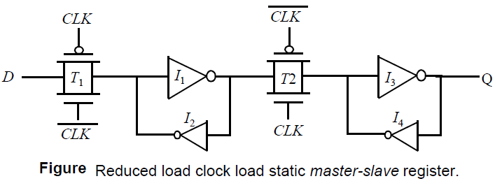
Drawback of transmission gate register
The drawback of the transmission gate register is the high capacitive load presented to the clock signal. The clock load per register is important, since it directly impacts the power dissipation of the clock network. Each register has a clock load of 8 transistors.
One approach to reduce the clock load at the cost of robustness is to make the circuit ratioed. Figure shows that the feedback transmission gate can be eliminated by directly cross coupling the inverters.
The penalty for the reduced clock load is increased design complexity. The transmission gate (T₁) and its source driver must overpower the feedback inverter (I₂) to switch the state of the cross-coupled inverter.
If minimum-sized devices are to be used in the transmission gates, it is essential that the transistors of inverter I₂ should be made even weaker. This can be accomplished by making their channel-lengths larger than minimum.

Slide 15
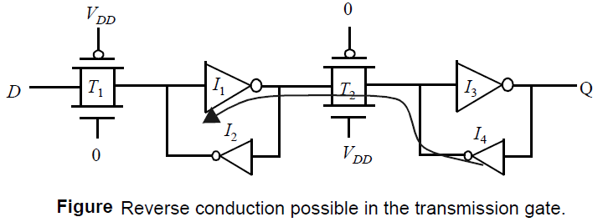
Continue….
Another problem with this scheme is the reverse conduction — this is, the second stage can affect the state of the first latch.
When the slave stage is on , it is possible for the combination of T2 and I4 to influence the data stored in I₁-I₂ latch.
As long as I4 is weak . This is not a major problem

Slide 16
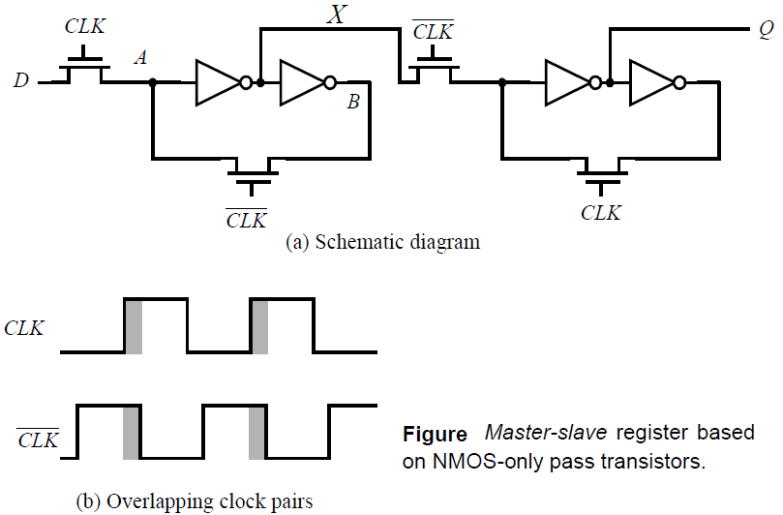
Non-ideal clock signals
clock skew is a major problem and causes the two clock signals to overlap . Clock-overlap can cause two types of failures, as illustrated for the NMOS-only negative master-slave register of Figure.
When the clock goes high, the slave stage should stop sampling the master stage output and go into a hold mode.
However, since CLK and CLK are both high for a short period of time (the overlap period), both sampling pass transistors conduct and there is a direct path from the D input to the Q output.
As a result, data at the output can change on the rising edge of the clock, which is undesired for a negative edge triggered register. The is know as a race condition in which the value of the output Q.
The primary advantage of the multiplexer-based register is that the feedback loop is open during the sampling period, and therefore sizing of devices is not critical to functionality. However, if there is clock overlap between CLK and CLK, node A can be driven by both D and B, resulting in an undefined state.

Slide 17
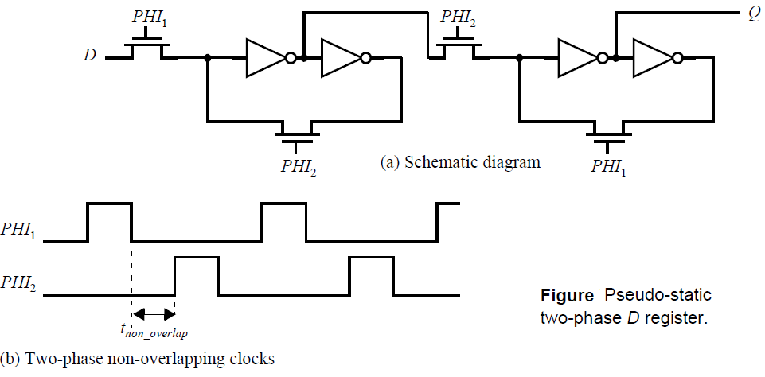
Continue….
Those problems can be avoided by using two non-overlapping clocks PHI₁ and PHI₂ instead , and by keeping the nonoverlap time tnon_overlap between the clocks large enough such that no overlap occurs even in the presence of clock-routing delays.
During the nonoverlap time, the FF is in the high-impedance state—the feedback loop is open, the loop gain is zero, and the input is disconnected. Leakage will destroy the state if this condition holds for too long a time. Hence the name pseudo-static:

Slide 18
Low-Voltage Static Latches
The scaling of supply voltages is critical for low power operation. Unfortunately, certain latch structures don’t function at reduced supply voltages.
At very low power supply voltages, the input to the inverter cannot be raised above the switching threshold, resulting in incorrect evaluation.
Scaling to low supply voltages hence requires the use of reduced threshold devices. However, this has the negative effect of exponentially increasing the sub-threshold leakage power.
However, with the use of conditional clocks, it is possible that registers are idle for extended periods and the leakage energy expended by registers can be quite significant.
Many solutions are being explored to address the problem of high leakage during idle periods. One approach for this involves the use of Multiple Threshold devices as shown in Figure

Slide 19
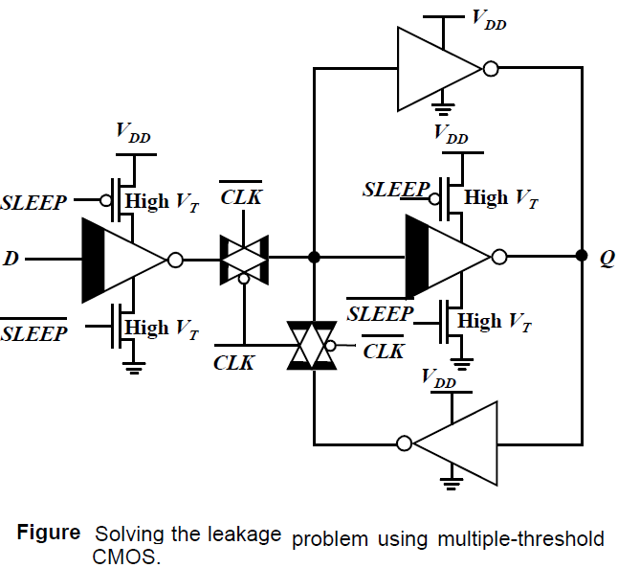
Continue…..
The shaded inverters and transmission gates are implemented in low-threshold devices.
During normal mode of operation, the sleep devices are tuned on. When clock is low, the D input is sampled and propagates to the output.
When clock is high, the latch is in the hold mode. The feedback transmission gate conducts and the cross-coupled feedback is enabled.
During idle mode, the high threshold devices in series with the low threshold inverter are turned off , eliminating leakage.

Slide 20
Dynamic latches and register
Storage in a static sequential circuit relies on the concept that a cross-coupled inverter pair produces a bistable element and can thus be used to memorize binary values.
The major disadvantage of the static gate, however, is its complexity. When registers are used in computational structures that are constantly clocked such as pipelined data path, the requirement that the memory should hold state for extended periods.
There is a class of circuits based on temporary storage of charge on parasitic capacitors. The absence of charge denotes a 0, while its presence stands for a stored 1.
No capacitor is ideal, unfortunately, and some charge leakage is always present. A stored value can hence only be kept for a limited amount of time, typically in the range of milliseconds.
If one wants to preserve signal integrity, a periodic refresh of its value is necessary. Hence the name dynamic storage.

Slide 21
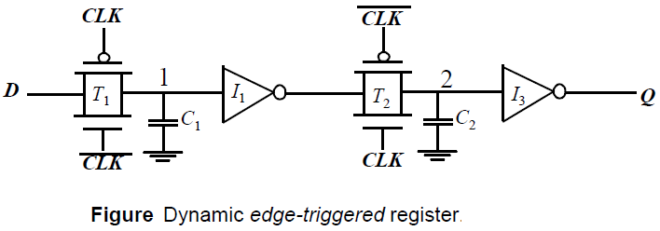
Dynamic Transmission-Gate Edge-triggered Registers
A fully dynamic positive edge-triggered register based on the master-slave concept.
When CLK = 0, the input data is sampled on storage node 1, which has an equivalent capacitance of C1 consisting of the gate capacitance of I1, the junction capacitance of T1, and the overlap gate capacitance of T1.
During this period, the slave stage is in a hold mode, with node 2 in a high-impedance (floating) state. On the rising edge of clock, the transmission gate T2 turns on, and the value sampled on node 1 right before the rising edge propagates to the output Q.
Node 2 now stores the inverted version of node 1. This implementation of an edge-triggered register is very efficient as it requires only 8 transistors.

Slide 22
Continue…..
The set-up time of this circuit is simply the delay of the transmission gate and corresponds to the time it takes node 1 to sample the D input.
The hold time is approximately zero, since the transmission gate is turned off on the clock edge and further inputs changes are ignored.
The propagation delay (tc-q) is equal to two inverter delays plus the delay of the transmission gate T2.
One important consideration for such a dynamic register is that the storage nodes (i.e., the state) has to be refreshed at periodic intervals to prevent a loss due to charge leakage.
The refresh rate is not an issue since the registers are periodically clocked, and the storage nodes are constantly updated.

Slide 23
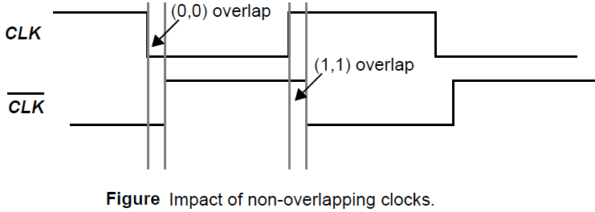
Clock overlap
Clock overlap is an important concern for this register
During the 0-0 overlap period create a direct path for data to flow from the D input of the register to the Q output. This is known as a race condition. The same is true for the 1-1 overlap region.
This high-high overlap case is taken care off by enforcing a hold time constraint.
The 0-0 overlap case can be addressed by making sure that there is enough delay between the D input and node 2 ensuring that new data sampled by the master stage does not propagate through to the slave stage.

Slide 24
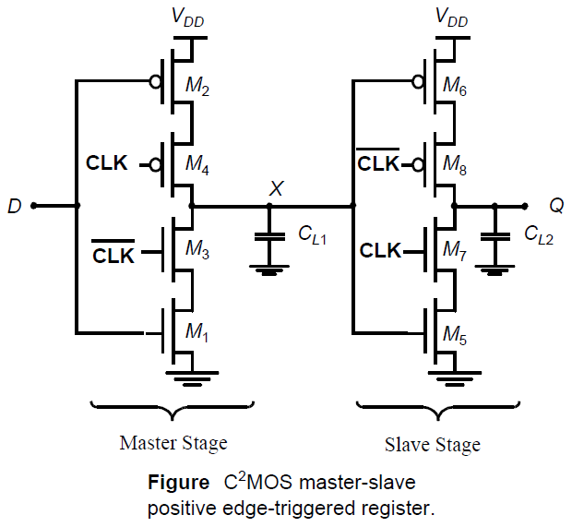
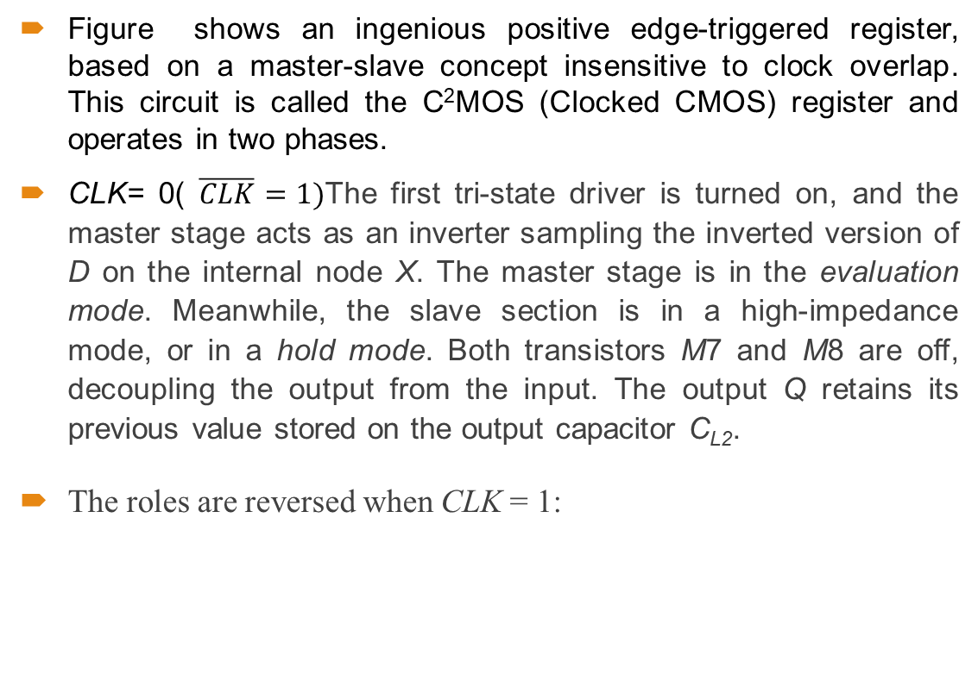
C²MOS—A Clock-Skew Insensitive Approach
Figure shows an ingenious positive edge-triggered register, based on a master-slave concept insensitive to clock overlap. This circuit is called the C²MOS (Clocked CMOS) register and operates in two phases.
CLK= 0( $\overline{CLK}=1)$The first tri-state driver is turned on, and the master stage acts as an inverter sampling the inverted version of D on the internal node X. The master stage is in the evaluation mode. Meanwhile, the slave section is in a high-impedance mode, or in a hold mode. Both transistors M7 and M8 are off, decoupling the output from the input. The output Q retains its previous value stored on the output capacitor C_{L2}.
The roles are reversed when CLK = 1:

Slide 25
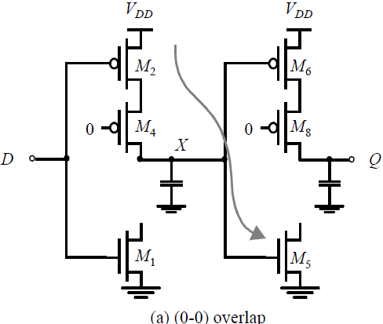

Continue…..
A C²MOS register with CLK-$\overline{CLK}$ clocking is insensitive to overlap, as long as the rise and fall times of the clock edges are sufficiently small.
In the (0-0) overlap case, the circuit simplifies to the network as shown in figure in which both PMOS devices are on during this period.
The question is does any new data sampled during the overlap window propagate to the output Q. since data should not change on the negative edge for a positive edge-triggered register
New data is sampled on node X through the series PMOS devices M2-M4, and node X can make a 0-to-1 transition during the overlap period. However, this data cannot propagate to the output since the NMOS device M7 is turned off.

Slide 26
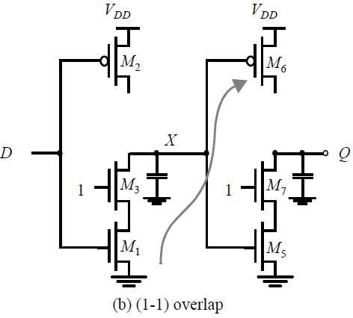
Continue…..
The (1-1) overlap case, where both NMOS devices M3 and M7 are turned on, is somewhat more contentious.
The question is again if new data sampled during the overlap period (right after clock goes high) propagates to the Q output.
A positive edge-triggered register may only pass data that is presented at the input before the rising edge.
If the D input changes during the overlap period, node X can make a 1-to-0 transition but cannot propagate to the output.
The problem of changing output in (1-1) overlap can be fixed by imposing hold-constraint on the input data D.

Slide 27
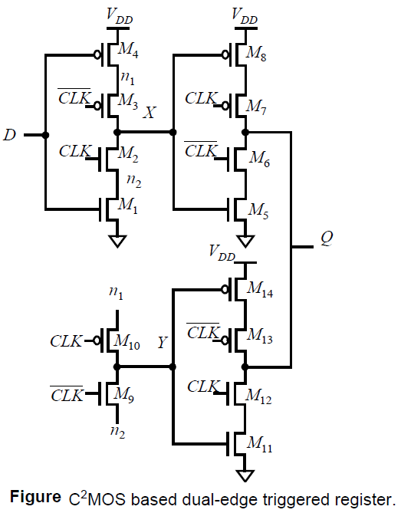
Dual-edge Registers
So far, we have focused on edge-triggered registers that sample the input data on only one of the clock edges (rising or falling). It is also possible to design sequential circuits that sample the input on both edges.
The advantage of this scheme is that a lower frequency clock (half of the original rate) is distributed for the same functional throughput, resulting in power savings in the clock distribution network.
Figure shows two parallel master slave-based edge-triggered registers, whose outputs are multiplexed using the tri-state drivers.
When clock is high, the positive latch composed of transistors M1-M4 is sampling the inverted D input on node X. Node Y is held stable, since devices M9 and M10 are turned off.

Slide 28
Continue….
On the falling edge of the clock, the top slave latch M5-M8 turns on, and drives the inverted value of X to the Q output.
During the low phase, the bottom master latch (M1, M4, M9, M10) is turned on, sampling the inverted D input on node Y.
On the rising edge, the bottom slave latch conducts, and drives the inverted version of Y on node Q. Data hence changes on both edges.
Note that the slave latches operate in a complementary fashion — this is, only one of them is turned on during each phase of the clock.

Slide 29
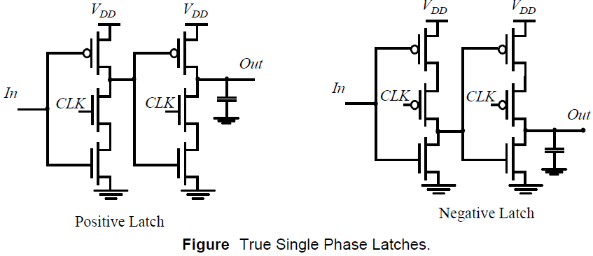
True Single-Phase Clocked Register (TSPCR)
In the two-phase clocking schemes described above, care must be taken in routing the two clock signals to ensure that overlap is minimized.
The basic single-phase positive and negative latches. For the positive latch, when CLK is high, the latch is in the transparent mode and corresponds to two cascaded inverters
On the other hand, when CLK = 0, both inverters are disabled, and the latch is in hold-mode. Only the pull-up networks are still active, while the pull-down circuits are deactivated.
As a result of the dual-stage approach, no signal can ever propagate from the input of the latch to the output in this mode. A register can be constructed by cascading positive and negative latches.
The main advantage is the use of a single clock phase. The disadvantage is the slight increase in the number of transistors — 12 transistors arerequired

Slide 30
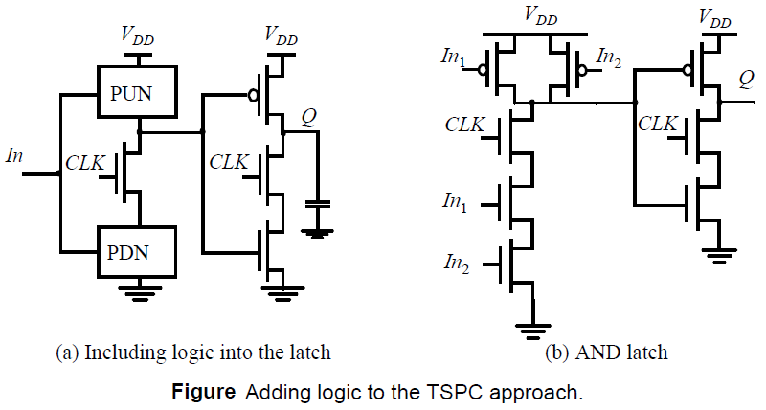
Continue…..
TSPC offers an additional advantage: the possibility of embedding logic functionality into the latches. This reduces the delay overhead associated with the latches.
Figure (a) outlines the basic approach for embedding logic. Figure (b) shows anexample of a positive latch that implements the AND of In1 and In2 in addition to performing the latching function.
This approach of embedding logic into latches has been used extensively in the design of the EV4 DEC Alpha microprocessor [Dobberpuhl92] and many other high-performance processors.

Slide 31
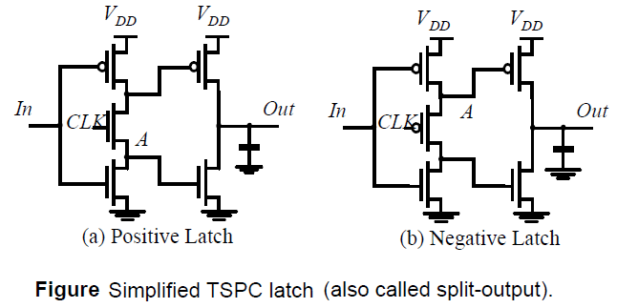
Continue….
The TSPC latch circuits can be further reduced in complexity. where only the first inverter is controlled by the clock. Besides the reduced number of transistors, these circuits have the advantage that the clock load is reduced by half.
On the other hand, not all node voltages in the latch experience the full logic swing. For instance, the voltage at node A (for Vin = 0 V) for the positive latch maximally equals VDD– VTn, which results in a reduced drive for the output NMOS transistor and a loss in performance.
Similarly, the voltage on node A (for Vin = VDD) for the negative latch is only
driven down to |VTp|. This also limits the amount of VDD scaling possible on the latch.

Slide 32
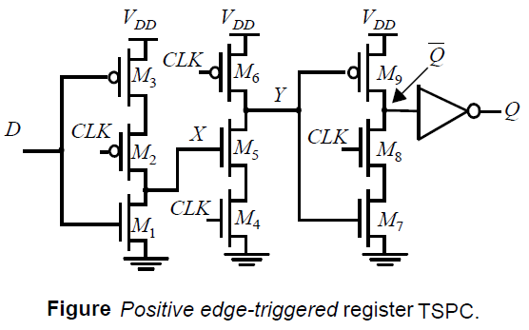
Continue….
Figure shows the design of a specialized single-phase edge-triggered register.
When CLK = 0, the input inverter is sampling the inverted D input on node X.
The second (dynamic) inverter is in the pre-charge mode, with M₆ charging up node Y to V_{DD}. The third inverter is in the hold mode, since M₈ and M₉ are off.
During the low phase of the clock, the input to the final (static) inverter is holding its previous value and the output Q is stable.
On the rising edge of the clock, the dynamic inverter M4-M6 evaluates. If X is high on the rising edge, node Y discharges. The third inverter M7-M8 is on during the high phase, and the node value on Y is passed to the output Q.

Slide 33
Continue……..
On the positive phase of the clock, note that node X transitions to a low if the D input transitions to a high level. Therefore, the input must be kept stable till the value on node X before the rising edge of the clock propagates to Y. This represents the hold time of the register.
The propagation delay of the register is essentially three inverters since the value on node X must propagate to the output Q.
Finally, the set-up time is the time for node X to be valid, which is one inverter delay.

Slide 34
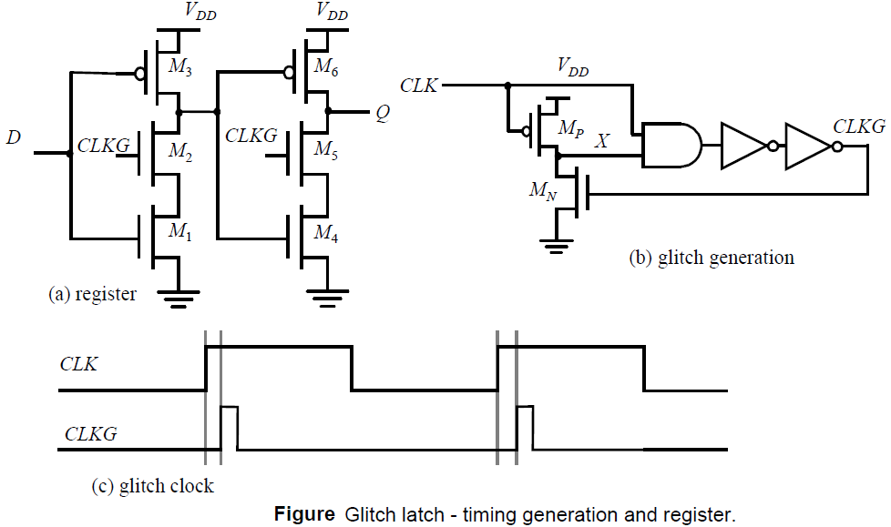
Pulse Registers
Until now, we have used the master-slave configuration to create an edge-triggered register.
A fundamentally different approach for constructing a register uses pulse signals. The idea is to construct a short pulse around the rising (or falling) edge of the clock.
This pulse acts as the clock input to a latch , sampling the input only in a short window. Race conditions are thus avoided by keeping the opening time (i.e, the transparent period) of the latch very short.
Figure shows an example circuit for constructing a short intentional glitch on each rising edge of the clock. When CLK = 0, node X is charged up to V_{DD} (M_{N} is off since CLKG is low).

Slide 35
Continue……
On the rising edge of the clock, there is a short period of time when both inputs of the AND gate are high, causing CLKG to go high.
This in turn activates MN, pulling X and eventually CLKG low. The length of the pulse is controlled by the delay of the AND gate and the two inverters.
If set-up time and hold time are measured in reference to the rising edge of the glitch clock, the set-up time is essentially zero, the hold time is equal to the length of the pulse and the propagation delay equals two gate delays
The advantage of the approach is the reduced clock load and the small number of transistors required. The glitch-generation circuitry can be amortized over multiple register bits.
The disadvantage is a substantial increase in verification complexity because process variations and load variations may cause the delays through the glitch clock circuitry to be different.

Slide 36
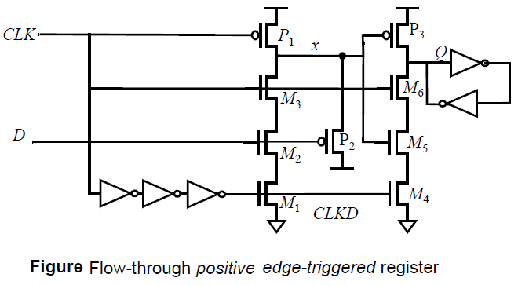
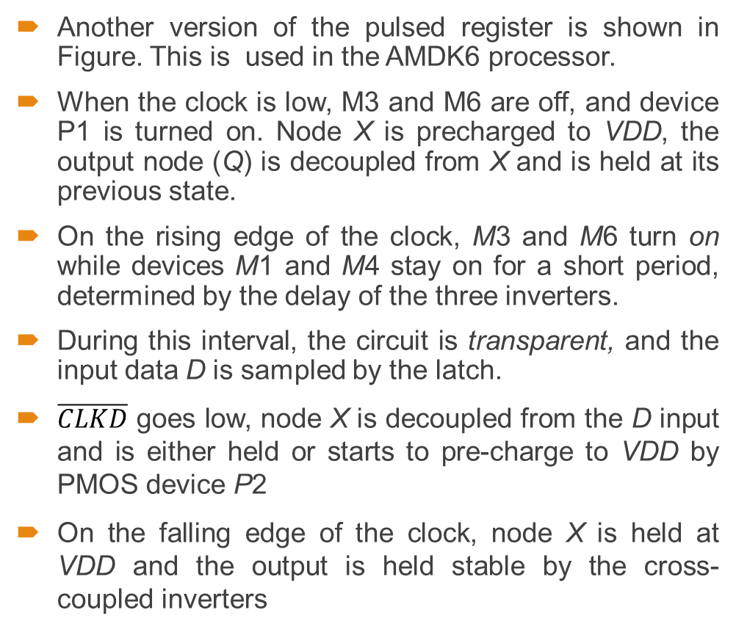
Continue….
Another version of the pulsed register is shown in Figure. This is used in the AMDK6 processor.
When the clock is low, M3 and M6 are off, and device P1 is turned on. Node X is precharged to VDD, the output node (Q) is decoupled from X and is held at its previous state.
On the rising edge of the clock, M3 and M6 turn on while devices M1 and M4 stay on for a short period, determined by the delay of the three inverters.
During this interval, the circuit is transparent, and the input data D is sampled by the latch.
$\overline{CLKD}$ goes low, node X is decoupled from the D input and is either held or starts to pre-charge to VDD by PMOS device P2
On the falling edge of the clock, node X is held at VDD and the output is held stable by the cross-coupled inverters

Slide 37
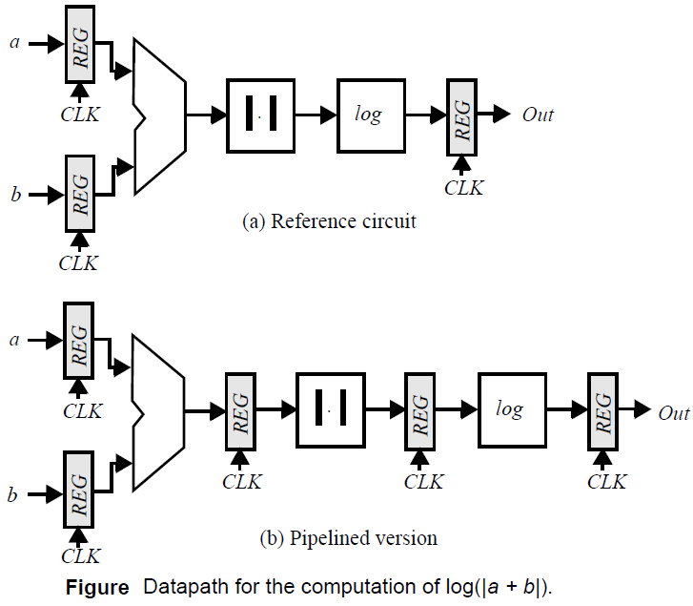
Pipelining: An approach to optimize sequential circuits
Pipelining is a popular design technique often used to accelerate the operation of the data paths in digital processors.
The idea is easily explained with the example of Figure a. The goal of the presented circuit is to compute log(|a - b|), where both a and b represent streams of numbers.
The minimal clock period T_{min} necessary to ensure correct evaluation is given as
where t_{c-q} and t_{su} are the propagation delay and the set-up time of the register, respectively. The term t_{pd,logic} stands for the worst-case delay path through the combinational network, which consists of the adder, absolute value, and logarithm functions.

Slide 38
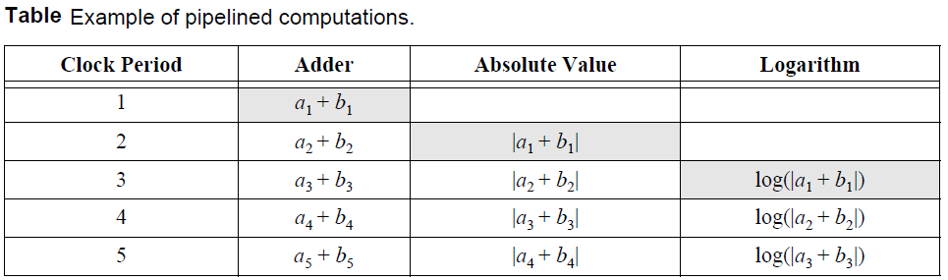
Continue……
Assume that each logic module has an equal propagation delay. We note that each logic module is then active for only 1/3 of the clock period (if the delay of the register is ignored).
Pipelining is a technique to improve the resource utilization and increase the functional throughput.
Assume that we introduce registers between the logic blocks, as shown in Figure b. This causes the computation for one set of input data to spread over a number of clock periods, as shown in Table.
The result for the data set (a₁, b₁) only appears at the output after three clock-periods. The computation is performed in an assembly-line fashion, hence the name pipeline.

Slide 39
Continue…..
The advantage of pipelined operation becomes apparent when examining the minimum clock period of the modified circuit.
The combinational circuit block has been partitioned into three sections, each of which has a smaller propagation delay than the original function.
This effectively reduces the value of the minimum allowable clock period:
The pipelined network outperforms the original circuit by a factor of three under these assumptions, or
T _{min,pipe}= T_{min}/3.
The increased performance comes at the relatively small cost of two additional registers. This explains why pipelining is popular in the implementation of very high-performance data paths.

Slide 40
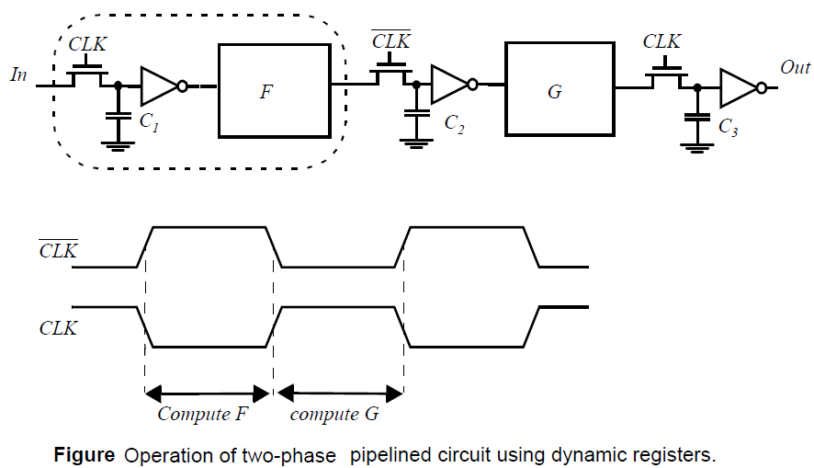
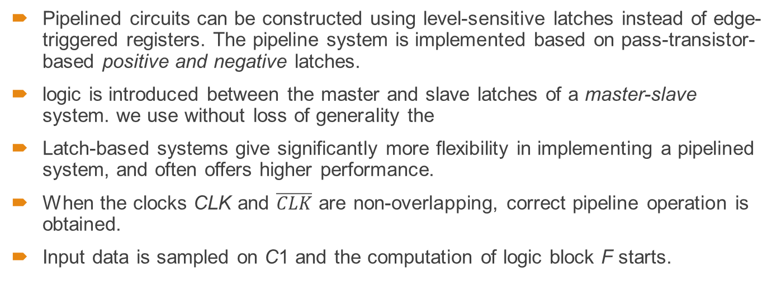
Latch- vs. Register-Based Pipelines
Pipelined circuits can be constructed using level-sensitive latches instead of edge-triggered registers. The pipeline system is implemented based on pass-transistor-based positive and negative latches.
logic is introduced between the master and slave latches of a master-slave system. we use without loss of generality the
Latch-based systems give significantly more flexibility in implementing a pipelined system, and often offers higher performance.
When the clocks CLK and $\overline{CLK}$ are non-overlapping, correct pipeline operation is obtained.
Input data is sampled on C1 and the computation of logic block F starts.

Slide 41
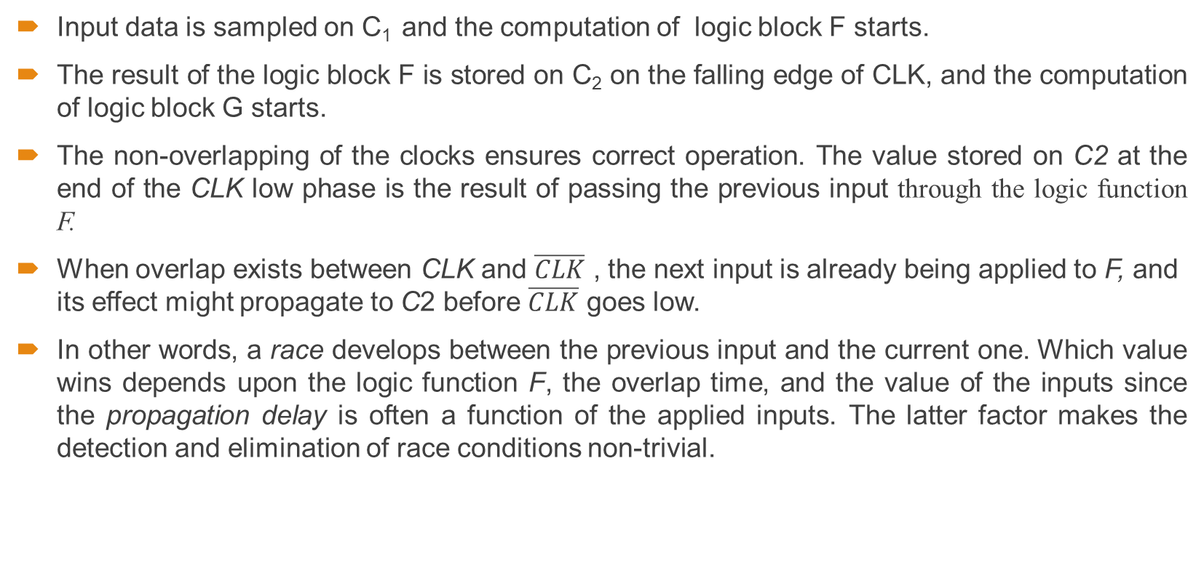
Continue….
Input data is sampled on C₁ and the computation of logic block F starts.
The result of the logic block F is stored on C₂ on the falling edge of CLK, and the computation of logic block G starts.
The non-overlapping of the clocks ensures correct operation. The value stored on C2 at the end of the CLK low phase is the result of passing the previous input through the logic function F.
When overlap exists between CLK and $\overline{CLK}$ , the next input is already being applied to F, and its effect might propagate to C2 before $\overline{CLK}$ goes low.
In other words, a race develops between the previous input and the current one. Which value wins depends upon the logic function F, the overlap time, and the value of the inputs since the propagation delay is often a function of the applied inputs. The latter factor makes the detection and elimination of race conditions non-trivial.

Slide 42
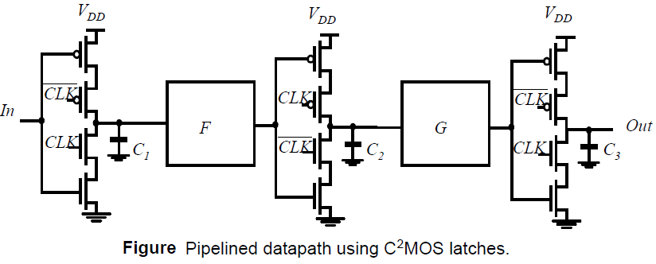
NORA-CMOS—A Logic Style for Pipelined Structures
The latch-based pipeline circuit can also be implemented using C²MOS latches.
A C²MOS-based pipelined circuit is race-free as long as all the logic functions F (implemented using static logic) between the latches are non-inverting.
The reasoning for the above argument is similar to the argument made in the construction of a C²MOS register.

Slide 43
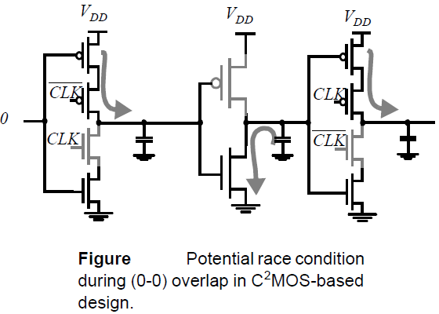
Continue….
The only way a signal can race from stage to stage under this condition is when the logic function F is inverting,
Based on this concept, a logic circuit style called NORA-CMOS was conceived. It combines C²MOS pipeline registers and NORA dynamic logic function blocks. Each module consists of a block of combinational logic that can be a mixture of static and dynamic logic, followed by a C²MOS latch.

Slide 44
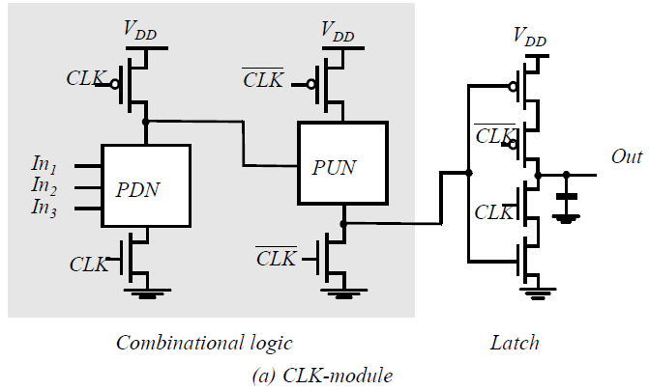

Continue….
Logic and latch are clocked in such a way that both are simultaneously in either evaluation, or hold (precharge) mode. A block that is in evaluation during CLK = 1 is called a CLK-module, while the inverse is called a $\overline{CLK}$ module.
A NORA data path consists of a chain of alternating CLK and CLK modules. While one class of modules is precharging with its output latch in hold mode, preserving the previous output value, the other class is evaluating. Data is passed in a pipelined fashion frommodule to module

Slide 45
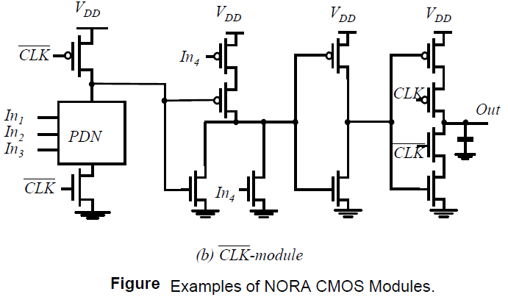
Continue….
NORA offers designers a wide range of design choices. Dynamic and static logic can be mixed freely, and both CLKp and CLKn dynamic blocks can be used in cascaded or in pipelined form. With this freedom of design, extra inverter stages, as required in DOMINO-CMOS, are most often avoided.

Slide 46
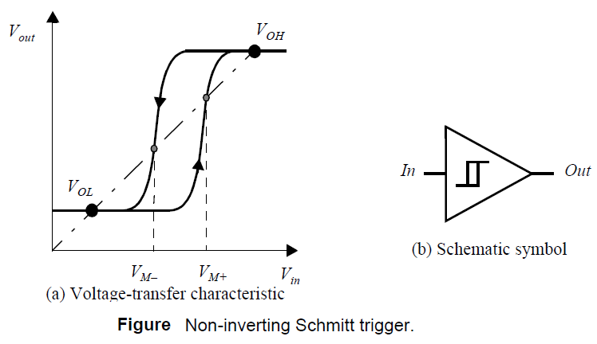
The Schmitt Trigger
Definition
A Schmitt trigger is a device with two important properties.
1. It responds to a slowly changing input waveform with a fast transition time at the output.
2.The voltage-transfer characteristic of the device displays different switching thresholds for positive- and negative-going input signals.
The switching thresholds for the low-to-high and high to- low transitions are called V_{M+} and V_{M-}, respectively. The hysteresis voltage is defined as the difference between the two.

Slide 47
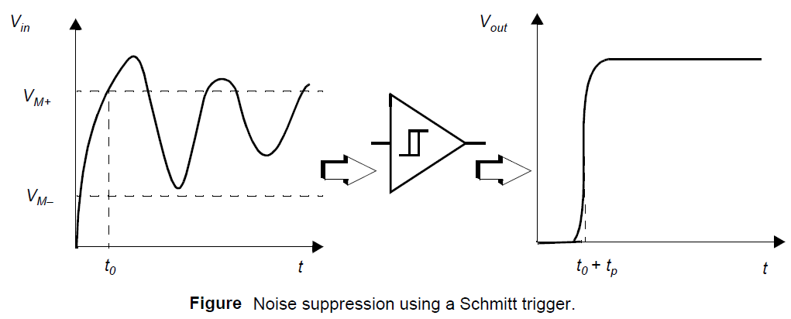
Continue…..
One of the main uses of the Schmitt trigger is to turn a noisy or slowly varying input signal into a clean digital output signal.
We can notice in figure how the hysteresis suppresses the ringing on the signal.
At the same time, the fast low-to-high transitions of the output signal should be observed. For instance, steep signal slopes are beneficial in reducing power consumption by suppressing direct-path currents.

Slide 48
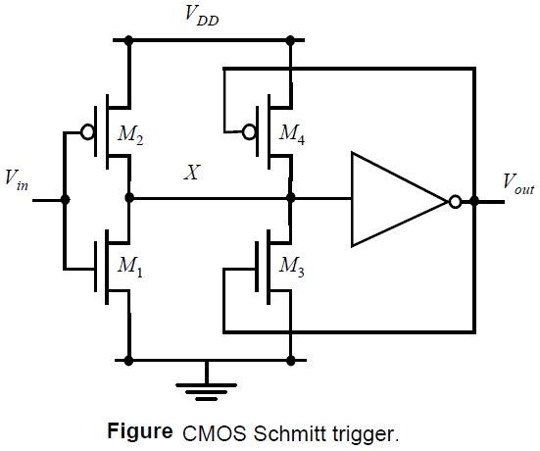
CMOS Implementation of Schmitt trigger
One possible CMOS implementation of the Schmitt trigger is shown in Figure.
The idea behind this circuit is that the switching threshold of a CMOS inverter is determined by the (kn/kp) ratio between the NMOS and PMOS transistors.
Increasing the ratio results in a reduction of the threshold, while decreasing it results in an increase in VM.
Adapting the ratio depending upon the direction of the transition results in a shift in the switching threshold and a hysteresis effect.

Slide 49
Continue….
Suppose that Vin is initially equal to 0, so that V_{out} = 0 as well. The feedback loop biases the PMOS transistor M4 in the conductive mode while M3 is off.
The input signal effectively connects to an inverter consisting of two PMOS transistors in parallel (M₂+M₄) as a pull-up network, and a single NMOS transistor (M₁) in the pull-down chain. This modifies the effective transistor ratio of the inverter to k_{M1}/(k_{M2}+k_{M4}), which moves the switching threshold upwards.
Once the inverter switches, the feedback loop turns off M₄, and the NMOS device M₃ is activated. This extra pull-down device speeds up the transition and produces a clean output signal with steep slopes. A similar behavior can be observed for the high-to-low transition.

Slide 50
Thank You

